Slide 1
Deep Learning Part 2
Other networks
Slides by:
Joseph E. Gonzalez,
jegonzal@berkeley.edu

Slide 2

Quick Logistics
http://bit.ly/aisys-sp19
Please sign up to present
Complete reading questions before lecture
Skim the reading for the lecture you are presenting (later in semester).
Is there a better paper?

Slide 3
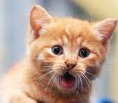
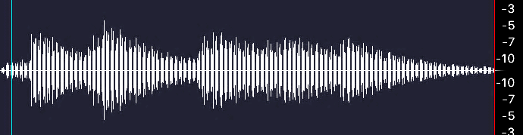
Machine Learning ≈ Function Approximation
Last Time
Object Recognition
Speech Recognition
“The cat in the hat”
Label:Cat
Robotic Control
Machine Translation
El gato en el sombrero
The cat in the hat.

Slide 4
Architectures for Different kinds of inputs
Convolutional Networks
Recurrent Networks
spatial reasoning tasks
Sequential reasoning tasks
El gato en el sombrero
The cat in the hat.
Reinforcement Learning
The quick brown fox…
Speech
recognition

Slide 5
Architectures for Different kinds of inputs
Convolutional Networks
Recurrent Networks
Graph Networks
spatial reasoning tasks
Sequential reasoning tasks
Operating on graph data
El gato en el sombrero
The cat in the hat.
Reinforcement Learning
Link Prediction
The quick brown fox…
Speech
recognition
Graph
Embedding

Slide 6


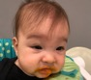
Supervised Machine Learning
Last Time
Given data containing the function inputs and outputs
Data
Model
Goal
Loss
Input | Output
X₁ | Y₁
X₂ | Y₂
… | …
X_{n} | Y_{n}
cat
Parameters
Over all future data
baby
Training (approximates the goal over training data):
baby

Slide 7
Learning without Labels
Data
Can we learn what inputs look like?
Useful inductive bias when training for a later supervised task.
Often done when labeled data is available but limited
Convert to a supervised learning problem:
Input | Output
X₁ | Y₁
X₂ | Y₂
… | …
X_{n} | Y_{n}
cat
baby
baby

Slide 8
Learning without Labels
Can we learn what inputs look like?
Useful inductive bias when training for a later supervised task.
Often done when labeled data is available but limited
Convert to a supervised learning problem:
Data
Input | Output
X₁ | Y₁
X₂ | Y₂
… | …
X_{n} | Y_{n}
cat
baby
baby
Information
Bottleneck

Slide 9
Learning without Labels
Can we learn what inputs look like?
Useful inductive bias when training for a later supervised task.
Often done when labeled data is available but limited
Convert to a supervised learning problem:
Data
Input | Output
X₁ | Y₁
X₂ | Y₂
… | …
X_{n} | Y_{n}
cat
baby
baby
Information
Bottleneck

Slide 10
Xor Perceptrons

Slide 11
Perceptron Not Gate
Perceptron
x
-1
1
y
1
-1

Slide 12
And Gate Perceptron
x₁ | x₂
-1 | -1
-1 | 1
1 | -1
1 | 1
Perceptron
y
-1
-1
-1
1

Slide 13
Or Gate Perceptron
x₁ | x₂
-1 | -1
-1 | 1
1 | -1
1 | 1
Perceptron
y
-1
1
1
1

Slide 14
XOr Gate Perceptron
x₁ | x₂
-1 | -1
-1 | 1
1 | -1
1 | 1
Perceptron
y
-1
1
1
-1

Slide 15
Not
+1
-1
And
Or
XOr
-1
+1
+1
+1
+1
-1
-1
-1
-1
+1
-1
+1
No separating hyperplane

Slide 16
Using one hidden layer
1
1
y
-1
1
1
-1
x₁ | x₂
-1 | -1
-1 | 1
1 | -1
1 | 1
-1
-1
-1
1
1
0
-1

